Slide 1
SOME ACHIEVEMENTS 2013 – 2018
Christine Nellemann, November 2018

Slide 2
Aims
Collect and disseminate information on 3Rs
Initiate and support research within the 3Rs
Host international conference on 3Rs
Focus on international collaboration
Notes:
Welcome to our Fifth symposium
Time to look back – present some achievements
Our work in the Danish 3R-Center can be placed inside one of these four tasks

Slide 3
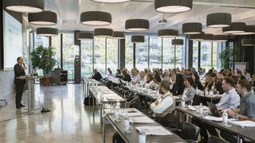
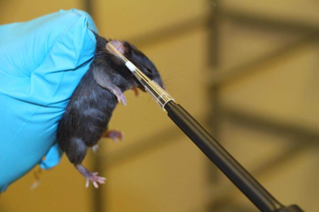
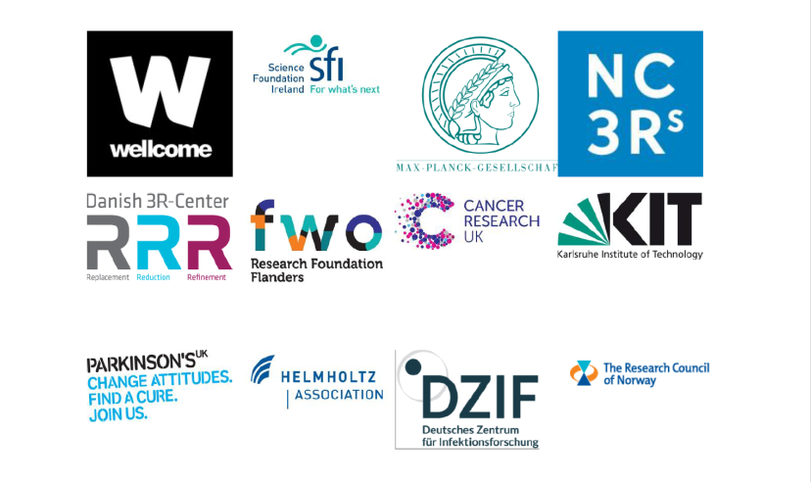
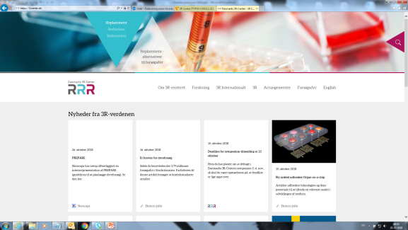
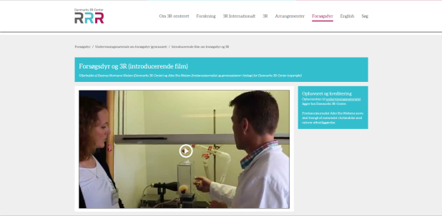
Activities
Notes:
To obtain our aims:
Symposium
Research Funding
Annual reports
Website
Teaching Material
3R-surveys
Funders' principles

Slide 4
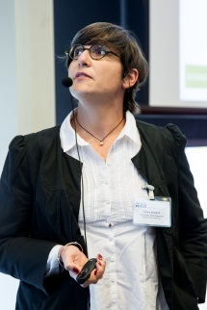
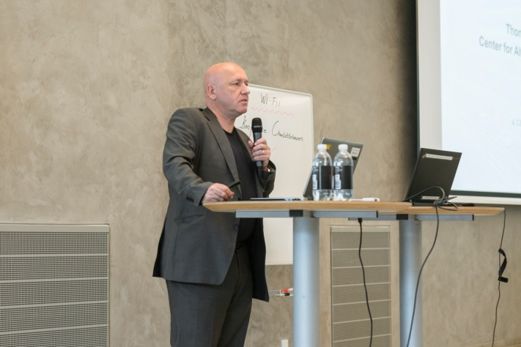
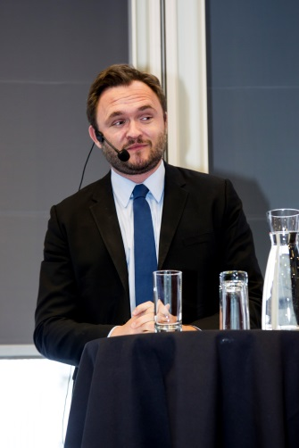
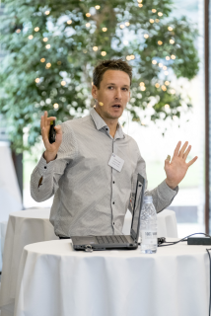
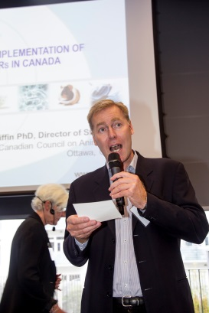
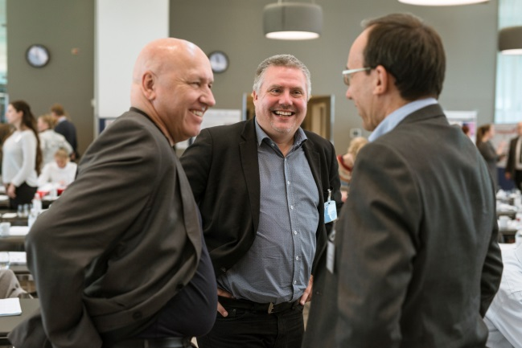
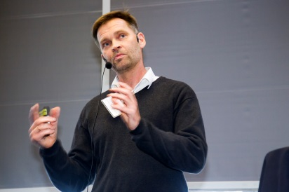
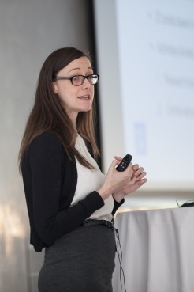
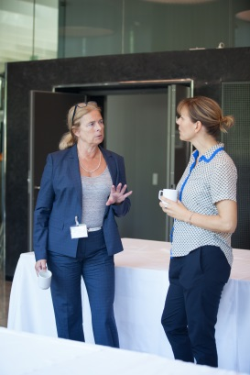
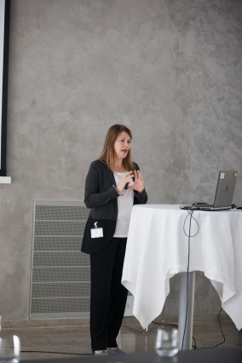
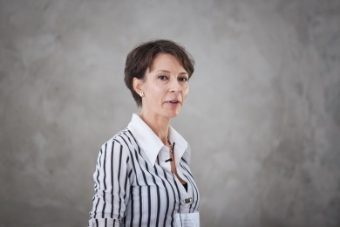
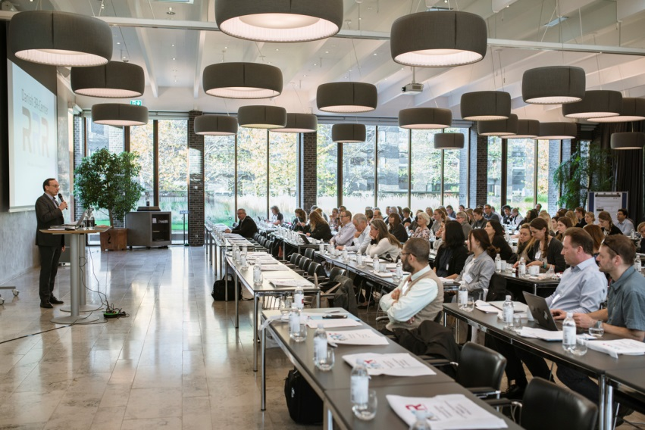
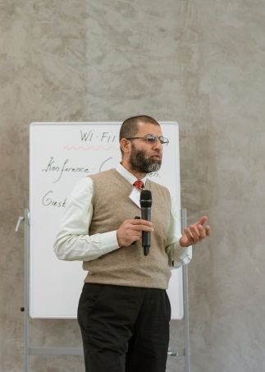
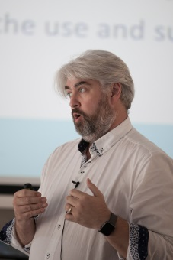
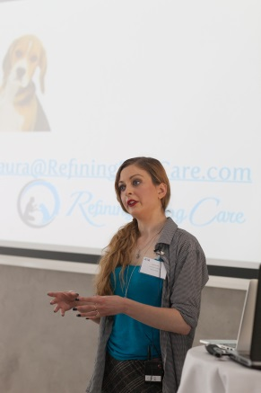
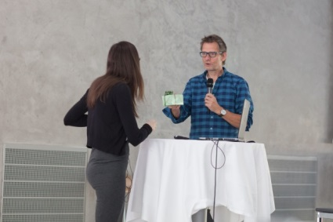
Symposium
Notes:
5 symposiums so far
76 talks (53 national, 24 international)
More and more participants each year – this year more than 200 participants (rekord)
This year around 30 international participants (plus international speakers)

Slide 5
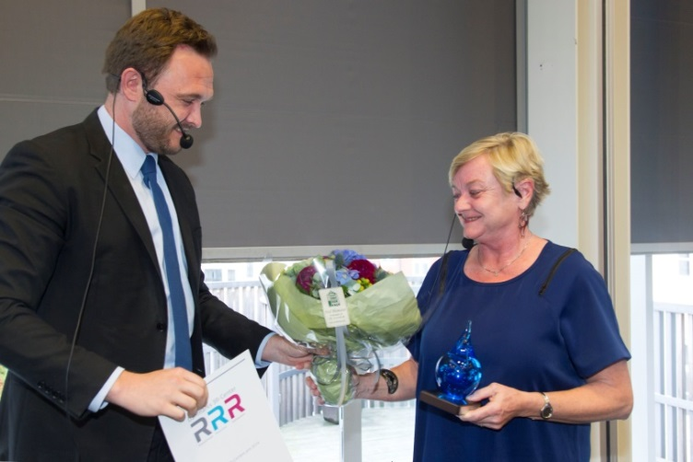
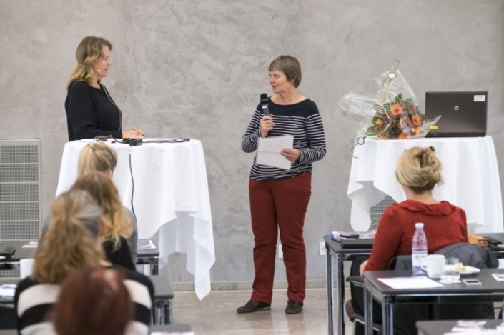
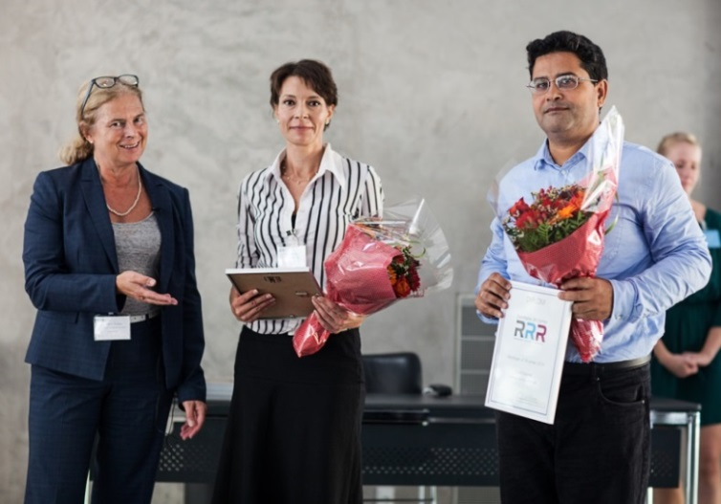
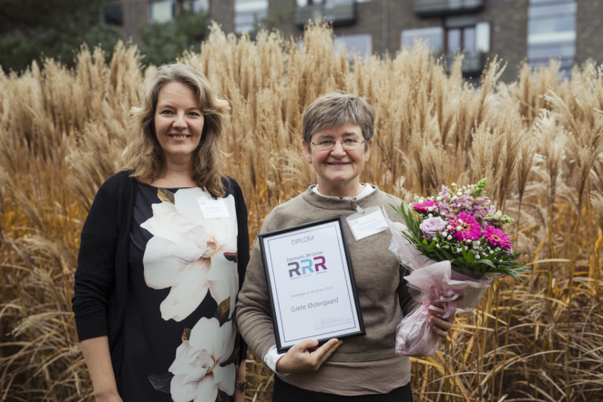
3R Prize
2015
2014
2016
2017
Notes:
Each year, the Danish 3R-Center gives an award to a person or group of persons affiliated with a company, university or other body who work to promote the 3Rs in Denmark.
Board Decision
The award is presented as part of our symposium.
Winners: Ellen Margrethe Vestergaard at the Danish Health Authority (2014), Hanne Gamst-Andersen at Novo Nordisk (2015), the QSAR-team at DTU (2016) and Grete Østergaard at University of Copenhagen (2017). Fifth prize will be presented tomorrow.

Slide 6
Research Funding
2014
Refinement of animal models of pain: Establishment of strategies to alleviate avoidable pain in rat models for pain and inflammation
Pathological and immunological consequences of basic experimental animal procedures in mice
Reducing the group size in studies of dermatitis by standardization of the gut microbiota
Establishment of an In vitro model for diabetic atherosclerosis
2015
An in vitro method to predict acute lung toxicity due to pulmonary surfactant inhibition
A Refined Approach to Producing Polyclonal Antibodies in Chickens – Completely Replacing All Invasive Elements by Combining Immunizations with Routine Aerosol-based Vaccinations
An alternative to animal experiments: Development of an in vitro human skin model for evaluation of topical antimicrobial compounds
2016
Development of computer models to predict chemicals interference with thyroid hormones
Towards better brain cancer treatment with novel in vitro models and fewer animal experiments
Use of cell culture technology to minimize the needs for animal trials in development and production of fish vaccines
2017
Use of Primary Isolates From Human Kidney to Study the Molecular Aspects of Blood Pressure Regulation
Developing FACS based in vitro assays to measure antibody mediated protection against infection with intracellular bacteria
Implementation of analgesic refinement in rats used as models for arthritis and inflammatory pain
2018
New advanced blood infection model
Transport and metabolism of azol antifungal drugs in the human term placenta
The mouse passport
Notes:
Supported 16 projects – replacement, reduction and refinement.
2018 projects are presented later to today
In december we decide which projects to support in 2019.
Research published in journals like "Scientific Reports", Plos One", "ALTEX Online", "Computational Toxicology", "Journal of Neuro Oncology", Journal of Quantitative Cell Sciences"

Slide 7
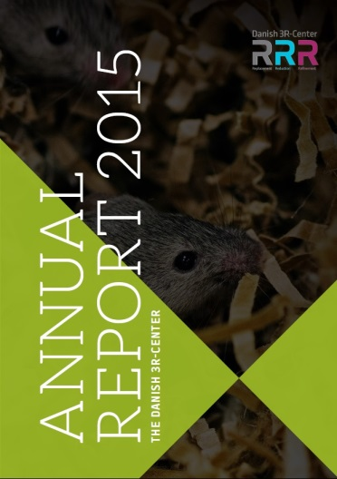
Annual Report
Notes:
Four Annual Reports – the last three also in English (available on our website)
2018 Annual report will be published in March 2019

Slide 8
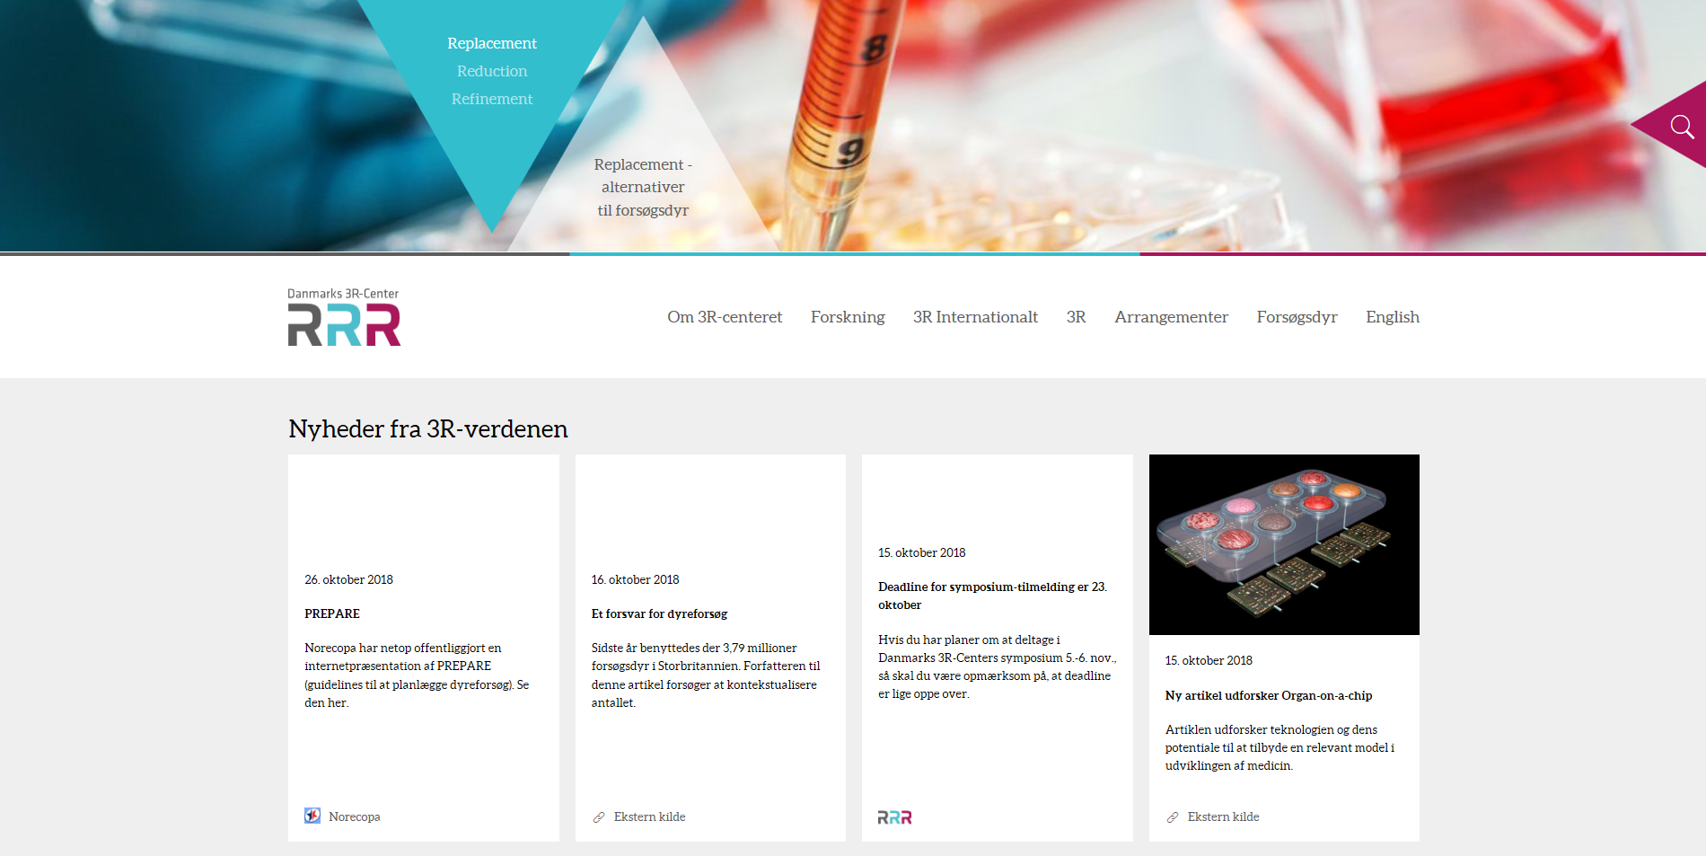
Website
Notes:
Increasing number of page views every year
News several times a week for professionals (in Danish and English)
Disseminate facts about laboratory animals (from The Animal Experiments Inspectorate) – for non professionals - especially for primary school/high school students
It is important for us to give people access to facts
Information about:
Which animals are used as laboratory animals?
How many?
Purpose
Even severity

Slide 9
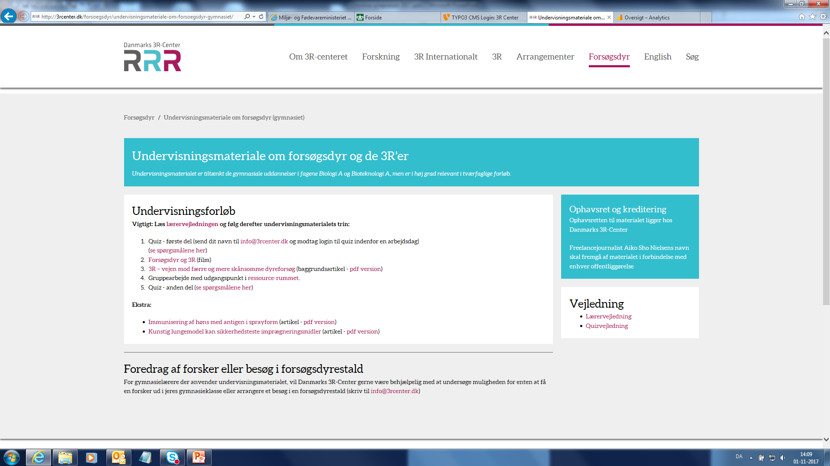
Teaching Material
Notes:
We have produced Teaching Material on laboratory animals and the 3Rs (in Danish)
Available for free at www.3RCenter.dk
For high school (gymnasium) and lower-secondary school (grades 8–10)
We know for sure that at least 55 classes have used the material
Even a teacher teaching the veterinary students and the veterinary nurse students at NMBU Veterinærhøyskolen in Oslo is now using the quiz in the material
Focus on PR. Participation in big PR-event for Teachers in March 2019

Slide 10
The Danish 3R-survey
Notes:
The Danish 3R survey: knowledge, attitudes and experiences with the 3Rs among researchers involved in animal experiments in Denmark
The purpose of the Danish 3R Survey was to study the knowledge of, attitudes to and experiences with the 3Rs amongst Danish researchers involved with animal experiments, as well as their expectations of the Danish 3R Center. A total of 293 animal researchers answered a questionnaire designed to uncover these aspects of knowledge and attitudes towards the 3Rs.
The results point at some future action points that the Danish 3R-Center can pursue in their future activities. A dual strategy is recommended where the Center, on one hand, focusses its attention on disseminating information about the 3Rs to scientists in the public sector, where it is especially relevant to increase knowledge and the understanding as to how to make the 3Rs operational in the daily work. On the other hand, it is also important to offer conferences/seminars (e.g. the annual symposia) as especially requested by scientists in the private sector.
Survey available on website

Slide 11
Replacement in animal research – a qualitative study of barriers and opportunities
Investigation of the possibilities and challenges of implementing replacement on private and public research facilities using animals for scientific purposes.
The project focuses on social and cultural aspects, attitude and level of knowledge impacting the implementation of replacement.
The aim was to clarify which factors impact the implementation of replacement in Danish research communities using animals for scientific purposes.
Notes:
The survey is beeing presented tomorrow by Thomas Bøker Lund (University of Copenhagen)

Slide 12
Meetings and Conferences
Måned og år Dato: Organisation: Sted: Deltagere / (kontaktperson): Formål / Danmarks 3R-Centers mål: Aftaler: Opfølgening / initiativ:
2017-10 3.-4. oktober DCAW / NordCAW København Tom Bengtsen, Louise Holm Parby, Rasmus Normann Nielsen Vidensopdatering, netværk
2017-8 20.-24. august
10th World Congress on Alternatives and Animals in the Life Sciences Seattle Adrian Smith, Erwin L. Roggen, Jan Lund Ottesen, Tom Bengtsen, Louise Holm Parby, Rasmus Normann Nielsen Vidensopdatering, netværk Planlagt møde med Svensk 3R-Center i forbindelse med dets åbning i november
2017-6 30. maj-2.juni Scandlas København Adrian Smith, Axel Kornerup Hansen, Jan Lund Ottesen, Tom Bengtsen, Louise Holm Parby, Kirsten Bayer Andersen Vidensopdatering, netværk
2017-5 8.-9. maj NordCAW Tartu (Estland) Tom Bengtsen, Rasmus Normann Nielsen Indflydelse på udviklingen af regionale dyrevelfærdscentre. Videndeling på skandinavisk plan
2017-3 8. marts NC3Rs London Tom Bengtsen Netværk
2017-2 22. februar Animpact Webinar Online Jan Lund Ottesen, Peter Bollen, Kirsten Bayer Andersen Vidensopdatering
2016-12 8. december ANIMPACT final conference Bruxelles Erwin L. Roggen, Tom Bengtsen Webinar februar
2016-12EU Kommissionen: Non-Animal Approaches - The Way Forward Bruxelles Lisbeth E. Knudsen, Adrian Smith, Jan Lund Ottesen, Erwin L. Roggen, Tom Bengtsen, Kirsten Bayer Andersen Vidensopdatering international udvikling Følge udviklingen / evt. nye EU-regler
2016-12 1. december 2016 NordCAW Uppsala Tom Bengtsen, Rasmus Normann Nielsen, Lise Tønner (Mats Sjökvist) Indflydelse på udviklingen af regionale dyrevelfærdscentre. Videndeling på skandinavisk plan Mulighed for afholdelse af NordCAW konference i DK i 2017
2016-10 26. - 28. oktober 2016 Mattilsynet (Norge) Fødevarestyrelsen Tom Bengtsen, Rasmus Normann Nielsen, Kirsten Bayer Andersen (Marianne Furnes) Formidling af centerets arbejde og opbygning med henblik på fremtidigt samarbejde Norge vil implementere EU-direktivet og i den sammenhæng også iværksætte 3R-aktiviter i form at Nationalt udvalg / 3R-center løbende kontakt og opfølgning
2016-09 5.-6. september 2016 Møde vedr. forskningsstøtte Bruxelles Adrian Smith, Louise Holm Parby (NC3R´s) Workshop med forskningsfonde om øget fokus på 3R ved tildeling af støtte Arbejde videre med dette emne på dansk niveau
2016-09 1.-2. september 2016 Formøde NordCAW Uppsala Lise Tønner (Mats Sjökvist) Forberedelse af NordCAW konference i december. VID finansierer turen, men 3R-deltager i konferencen
2016-08 24.-27. august 2016 EUSAAT Linz Adrian Smith, Rasmus Normann Nielsen, Louise Holm Parby Poster om Danmarks 3R-center, vidensdeling, netværk Birgitte Kousholt, AU deltog med støtte fra 3R-center for at præsentere succes med dyrevelfærdsorgan. Aftale med EU-kommissionen
2016-08"EEMGS3R-tema / ECOPA" København Lisbeth E Knudsen, Tom Bengtsen Økonomisk samarbejde / poster om 3R-centeret hele ugen - Vidensdeling, netværk Kontakt til INERIS / Frankrig vedr. 3R-initiativer i Danmark
2016-06 16-17. juni. 2016 RSPCA International Meeting: Focus on severe suffering Bruxelles Peter Bollen, Jan Lund Ottesen Præsentation af Danmarks 3R-Center. Vidensdeling, netværk
2016-06 13-16. juni. 2016 FELASA kongres Bruxelles Peter Bollen, Erwin L. Roggen, Jan Lund Ottesen, Adrian Smith, Jesper Lassen, Tom Bengtsen, Kirsten Bayer Andersen Vidensopdatering, inspiration, netværk, præsentation af Danmarks 3R-Center samt af 3R undersøgelsen Præsentation af dansk dyrevelfærdsorgan på EUSAAT 2016. Kontakt med kommende belgisk 3R-Center Analyse og beskrivelse af Danmarks 3R-center sendt til Belgien
2016-05 31. maj-1. juni 2016 EURL-ECVAM - EU 3R-Centre Ispra Axel Kornerup Hansen, Adrian Smith, Tom Bengtsen (Maurice Whelan) 2. møde ved etablering af samarbejde mellem europæiske 3R-Centre Præsentation af resultater i 2015 / 2016. Forslag om etablering af formelt samarbejde. EU – kommissionen gennemfører en profilanalyse af alle centre for at dokumentere åbenlyse samarbejdsmuligheder
2016-03 Marts. 2016 NC3Rs prize event og besøg London Tom Bengtsen, Louise Bjørn Brønden (Vicky Robinson) Inspiration og samarbejde om initiativer som DK3R kan bruge/udvikle/kopiere Aftale om udnyttelse og promovering af NC3R initiativer; CRACK-IT (særligt solutions), ARRIVE, EDA grimace scales - Vurdering af ansøgninger //håndtering af fondsmidler Bestille materiale til brug ved konferencer etc. - Tage kontakt til Natalie vedr. EDA, som skal gribes rigtigt an - Ok at kontakte Emily mhp. yderligere info omkr sociale medier etc.
2015-11NORDCaw konference om kommunikation af dyrevelfærd, herunder forsøgsdyr Uppsala Tom Bengtsen (Mats Sjöquist) Præsentation af effekt og muligheder med åben dialog om anvendelse af forsøgsdyr Øget nordisk samarbejde om kommunikation af viden om forsøgsdyr og 3R Endnu en konference planlagt til 2016
2015-09 September. 2015 EUSAAT 3R konference Linz Erwin L. Roggen, Lisbeth E. Knudsen, Tom Bengtsen, Rasmus Normann Nielsen Inspiration og vidensdeling. Dialog med andre internationale interessenter. Præsentation af poster
2015-06 19. juni 2015 RIVM København Christine Nellemann, Lisbeth E. Knudsen, Tom Bengtsen (Anne Keinhuis) Inviteret til København 19. juli 2015. - Debat om faglig støtte til etablering af hollandsk 3R-center - Indsamle og formidle viden om alternativer til dyreforsøg - Samarbejde med lignende centre i udlande Gensidig dialog og link til hjemmesider
2015-05 20.-21. maj 2015 NORDCaw Uppsala Tom Bengtsen (Mats Sjöquist) Diskussion af mulighed for fælles nordisk 3R/dyrevelfærds-samarbejde. - Samarbejde med lignende centre i udlandet Etablering af informationsnetværk NordCAW - Fælles nordisk workshop under planlæggelse Danmark deltog som medarrangører af Nordcaw nordisk workshop om bl.a. artikel 47
2015-04 Forår 2015 Norecopa Oslo Adrian Smith, Rasmus Normann Nielsen Informationsudveksling via Adrian Smith - Indsamle og formidle viden om alternativer til dyreforsøg - Samarbejde med lignende centre i udlande Modtagelse af nyhedsbrev Deltagelse i årsmøde 2014 - Norske 3R-nyheder indgår i nyhedsoversigt. - Danmarks 3R-Center følger op mht. på nyhedssite
2015-04 21.-22- spril 2015 Swetox Ispra Erwin L. Roggen, Adrian Smith, Tom Bengtsen (Ian Cotgrove) Diskussion af mulighed for fælles nordisk 3R-samarbejde - Indsamle og formidle viden om alternativer til dyreforsøg - Samarbejde med lignende centre i udlande Fælles 3R-møde under planlægning Swetox vil tage initiativ til fælles nordisk arbejdsgruppe
Notes:
Participated in international meetings, councils, seminars and networks concerning 3R and Best Practice – oral presentations and posters
Organized meetings with other 3R Centers worldwide
Maintaining good international relations
Connecting with national parties involved in international 3R collaborations

Slide 13
Funders' principles (Joint European funding priciples for research involving animals)
Notes:
Research involving animals helps to enhance our understanding of human, animal and environmental health and biology. It raises many complex issues for example, ethics, animal welfare, transparency, reproducibility and translation. To maintain public confidence in research involving animals, and to build on standards of animal welfare we, as a funding community, abide by three key principles.
1. As funders we recognise our role in promoting high quality science, and that good animal welfare, and the 3Rs of Replacement, Reduction and Refinement, are integral to this. We aim to ensure we only fund research using animals that implements the 3Rs, is justifiable, and is relevant to clinical practice, to the health or welfare of animals, or to enhancing our knowledge of fundamental science.
2. Working collaboratively as a community, across Europe, can help us meet our goals. We will share good practice in grant making, and pool resources to improve animal welfare, and scientific outputs, in funded research.
3. We understand the importance of openness and transparency about research involving animals. Transparency is central to relevant, reproducible and replicable science. We will endeavour to be open - engaging about our funding, policies and processes. We will also strive to ensure the research we fund, as far as possible, is open and accessible in terms of data sharing and publication.

Slide 14
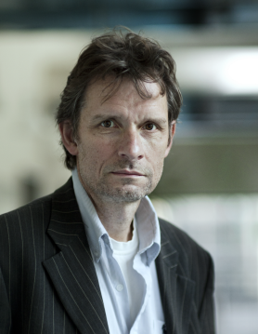
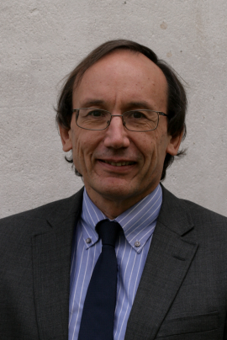
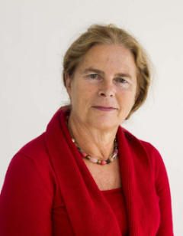
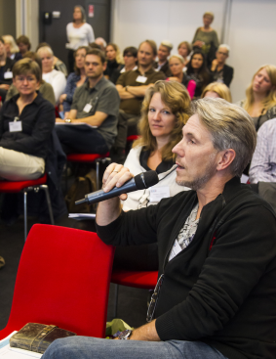
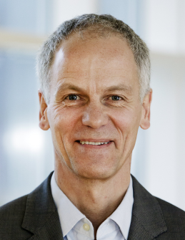
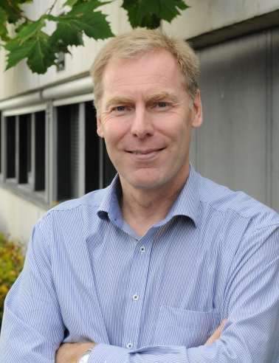
New Board 2017-2021
Notes:
New Board (2017-2021) appointed by the minister
Specialists (replacement, reduction and refinement)
Thank you to my board members…………

Slide 15
Stakeholders
Notes:
Thank you to our stakeholders…………..

Slide 16
Thank you for your attention

